Slide 1
Multisegmental Motor Output Analysis in Critically Ill Patients
Matthew Johnson, John Rattray, Dr. Pawel Kudela, Dr. Robert Stevens

Slide 2
Background
Coma
Many acute neurological conditions (stroke, traumatic brain injury) are associated with loss of consciousness (coma)
Glasgow Coma Scale (GCS)
In the clinical setting, consciousness is measured using the GCS
3 subscores of GCS: visual, verbal, and motor
Motor subscore is most predictive of the severity of brain injury and outcomes
GCS Motor Subscore (mGCS)
No Movement
Extension
Flexion
Withdrawal
Localization
Following Motor Commands

Slide 3
Problem
Problem
Current method for evaluating coma (GCS) is observer-dependent, non-quantitative, and is limited by poor inter-observer reliability
Goal
To design a multisegmental wearable movement tracking sensor network to establish a classification system or feature extraction system capable of accurately classifying brain-injured coma patients on the basis of the motor component of their GCS evaluation

Slide 4
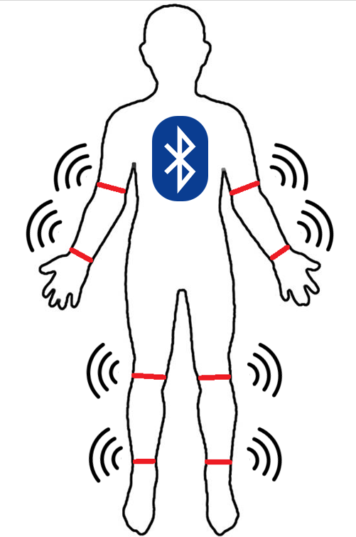

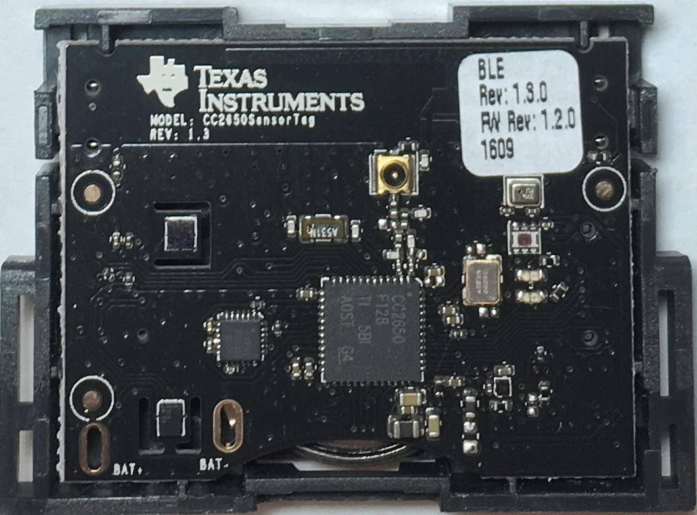
Method
Notes:
Explicitly mention wireless feature

Slide 5
Approach
Movelets
Movelets: a collection of three acceleration time samples in a window of a given size
By comparing a movelet of a small sample size to a larger dictionary sample, it is possible to distinguish different, unique movements
Approach
Create a dictionary of motor outputs training data specific to motor subscores of the GCS
Write an algorithm to accurately classify motor response data in coma patients

Slide 6
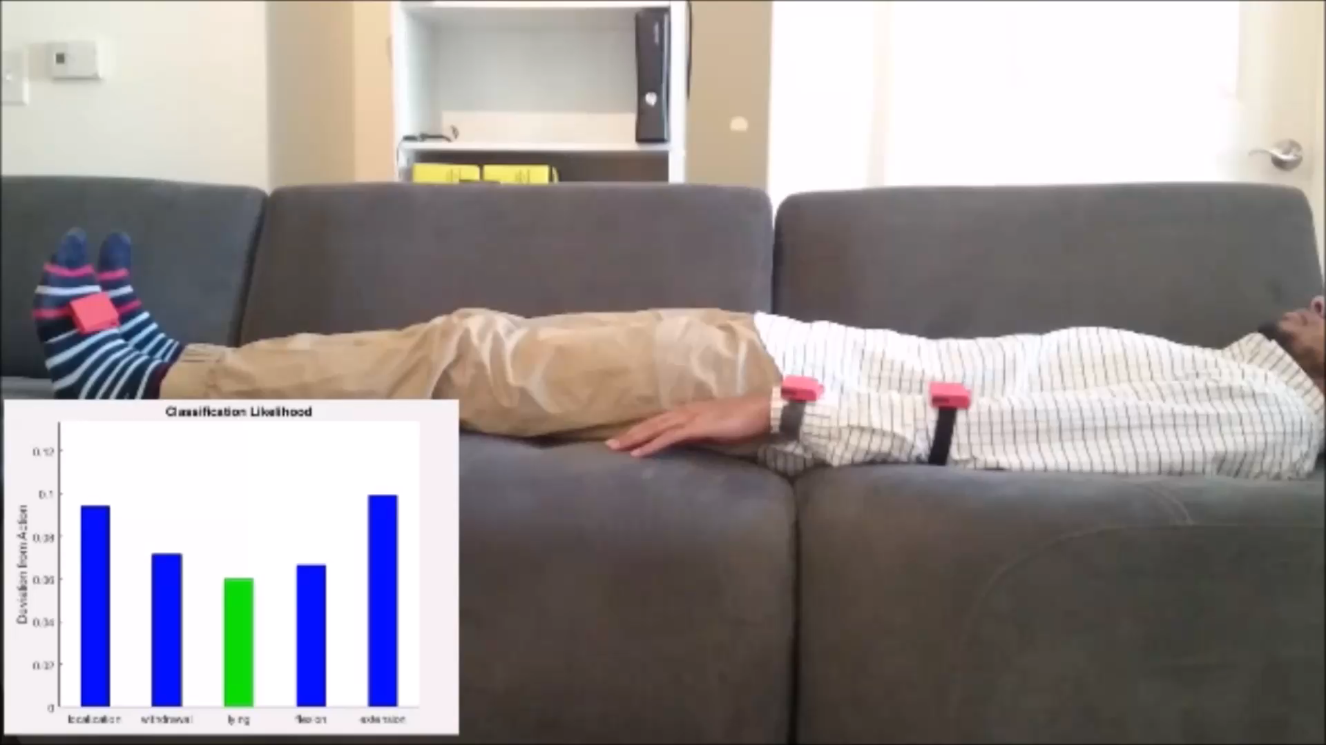
Results

Slide 7
Next Steps
Short Term Goals
Improve accuracy of mGSC classifications
Validate accuracy of classification algorithm in controls and in coma patients
Long Term Goals
Incorporate different machine learning algorithms to more accurately classify motor outputs
Replace TI SensorTag with custom-built device that is designed specifically to the needs of our project
Map motor output patterns to specific clinical trajectories and health outcomes in patients with neurological disorders

Slide 8
Questions?

